Slide 1
DHL QUIZ
31ST DECEMBER 2023
ENTERTAINMENT

Slide 2
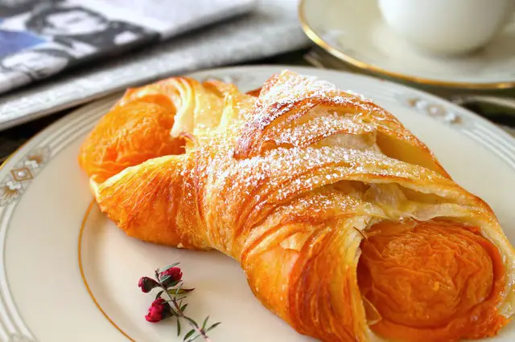
Q.1. What is the name of this pastry, which is typically made of a layered yeast-leavened dough with butter?
A. Macarons
B. Croissants
C. Danishes

Slide 3
B. Croissants

Slide 4
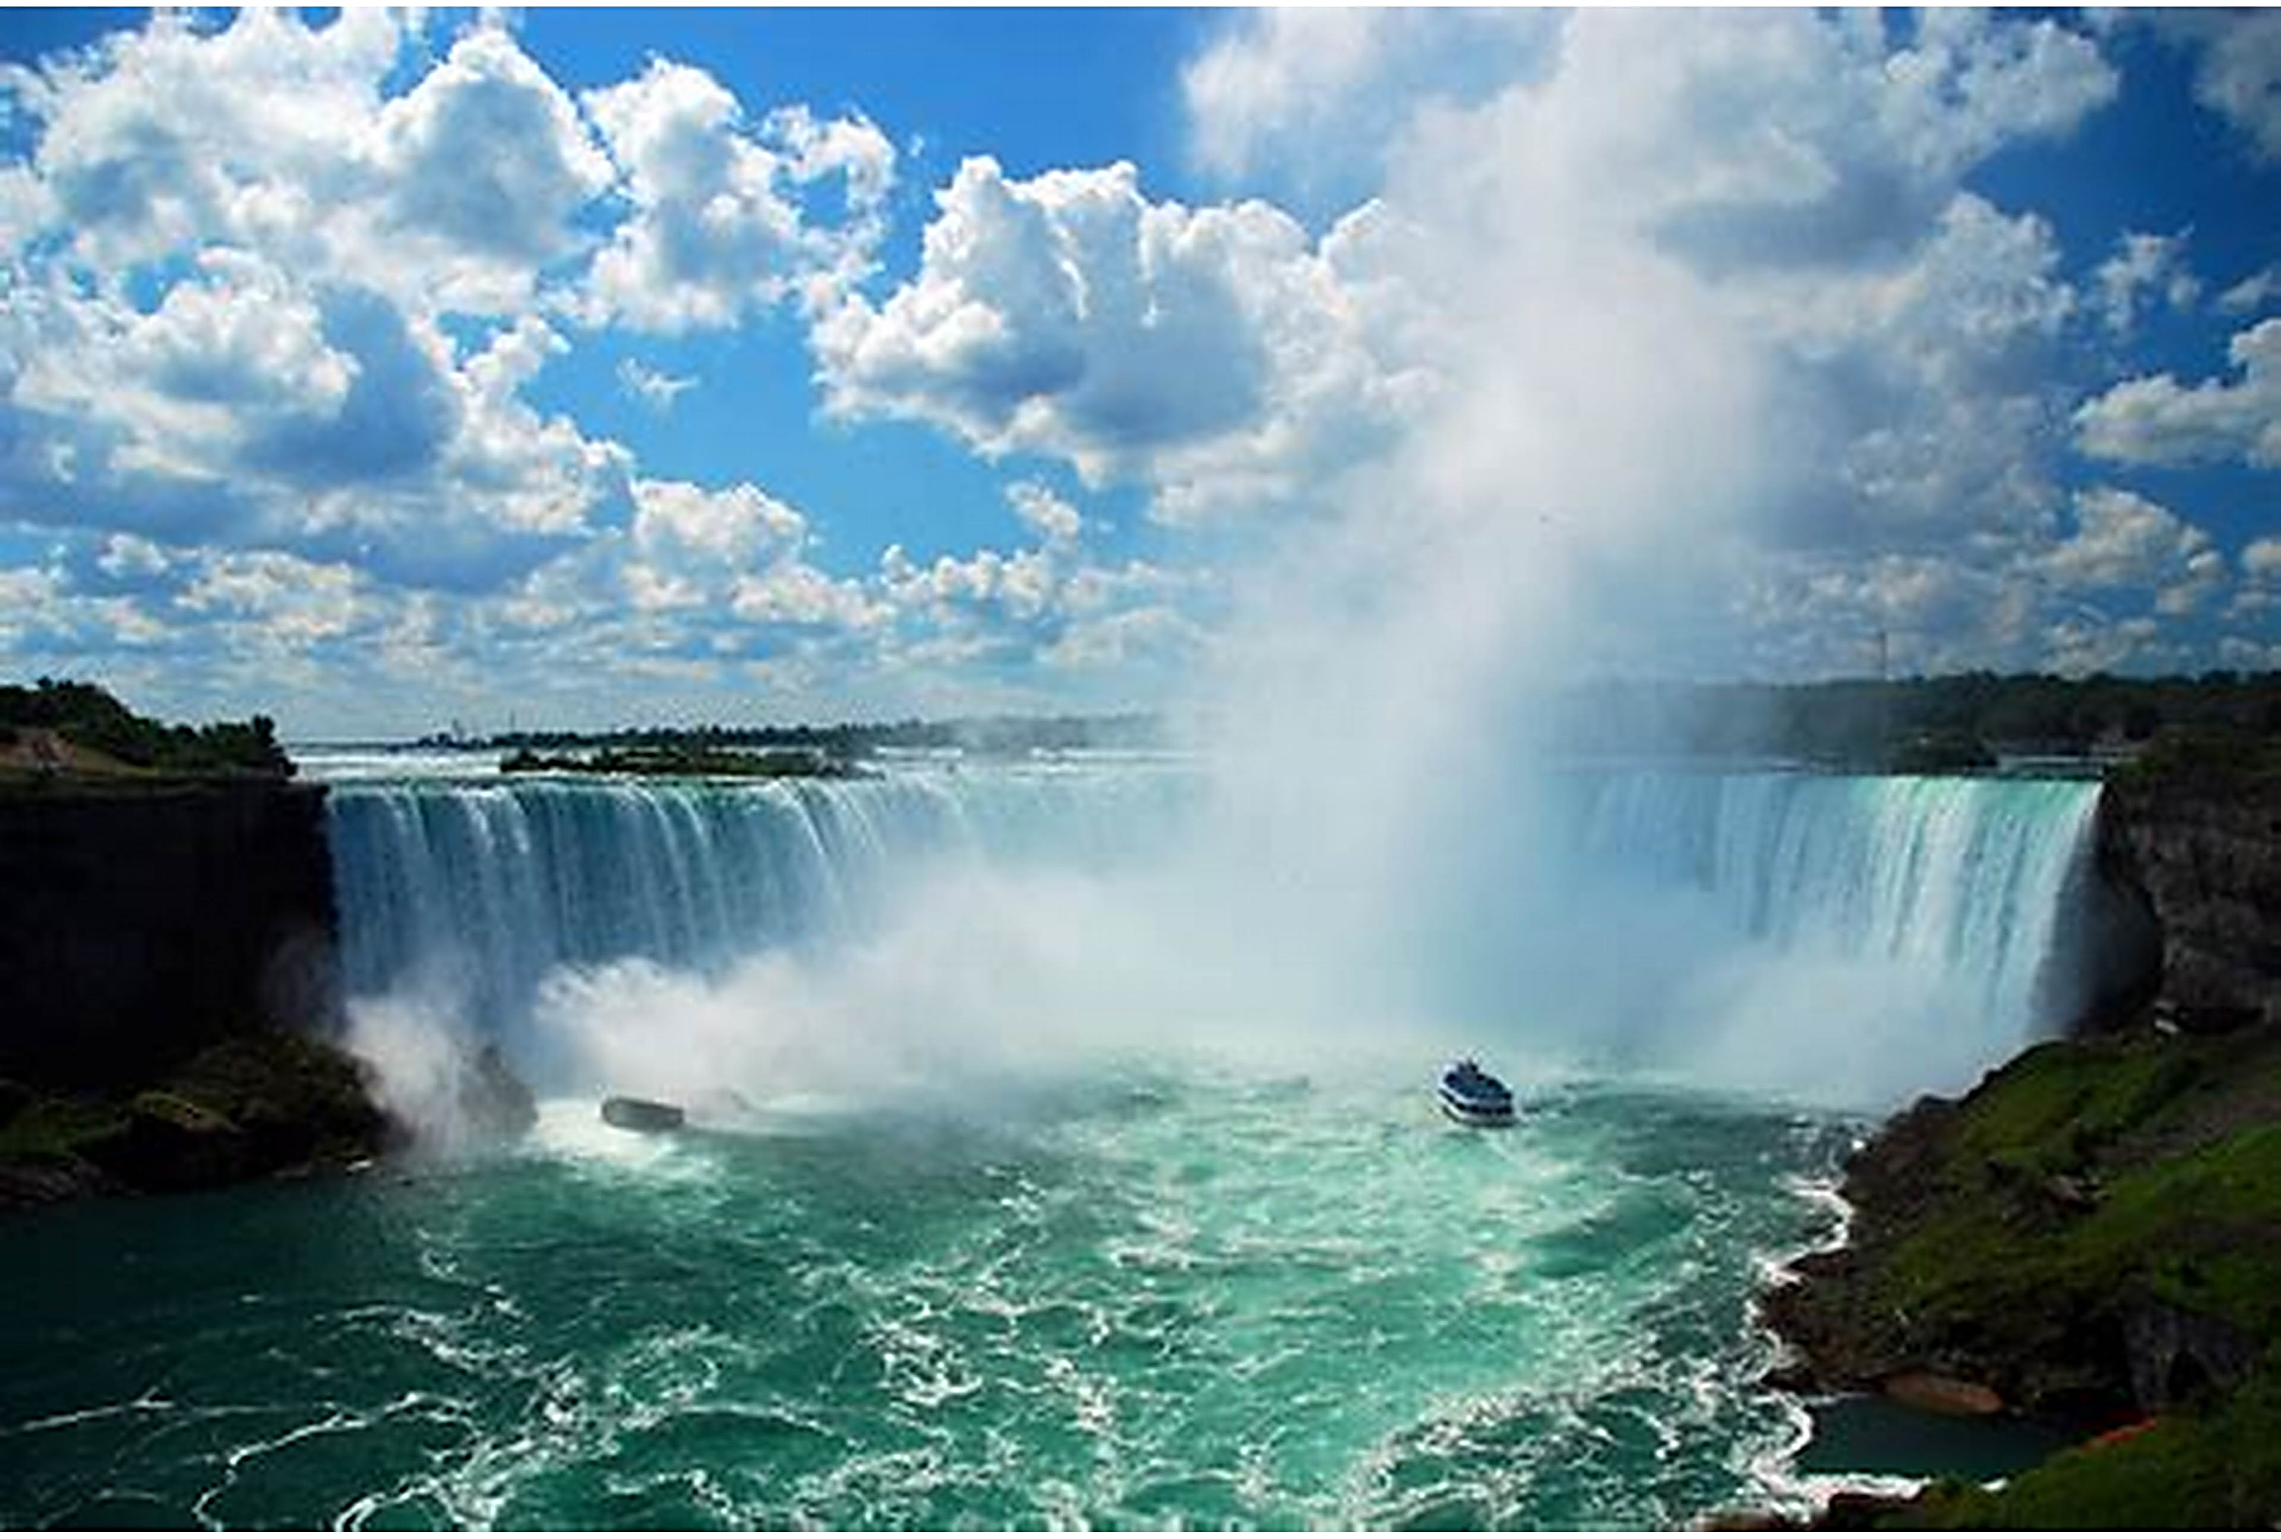
Q.2.Which historical landmark is this ?
Dhauladhar Falls
Niagara falls
Angel falls
Steall falls

Slide 5
NIAGARA FALLS

Slide 6
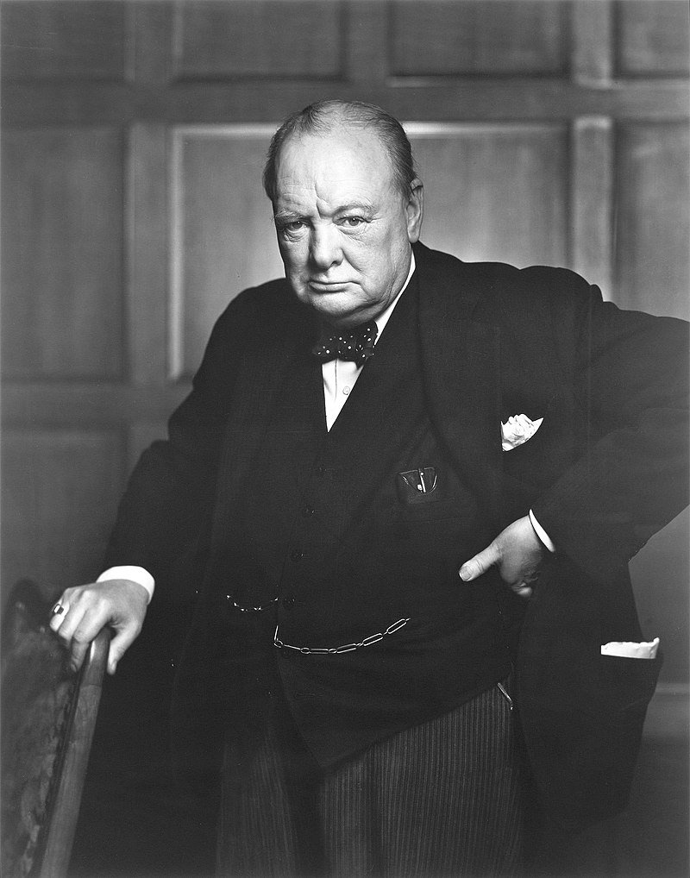
Q.3. IDENTIFY THIS FAMOUS PERSONALITY WHO LED BRITAIN TO VICTORY IN THE SECOND WORLD WAR.
HIROHITO
VLADMIR LENIN
WINSTON CHURCHILL
FRANKLIN D. ROOSEVELT

Slide 7
WINSTON CHURCHILL

Slide 8

Q.4.NAME THIS MAGNIFIED OBJECT
BUTTERFLY WINGS
FLOWER PETAL
PORCUPINE QUILL
SHARK TOOTH

Slide 9
BUTTERFLY WINGS

Slide 10
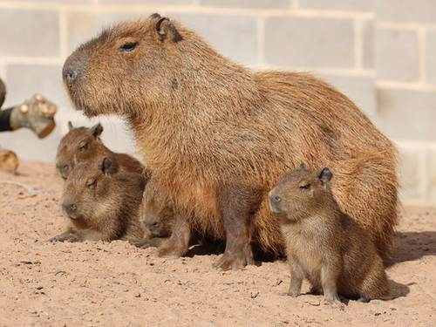
Q.5. NAME THIS INHABITANT OF SAVANNA.
GUINEA PIG
WOMBAT
CAPYBARA
PACA

Slide 11
CAPYBARA

Slide 12
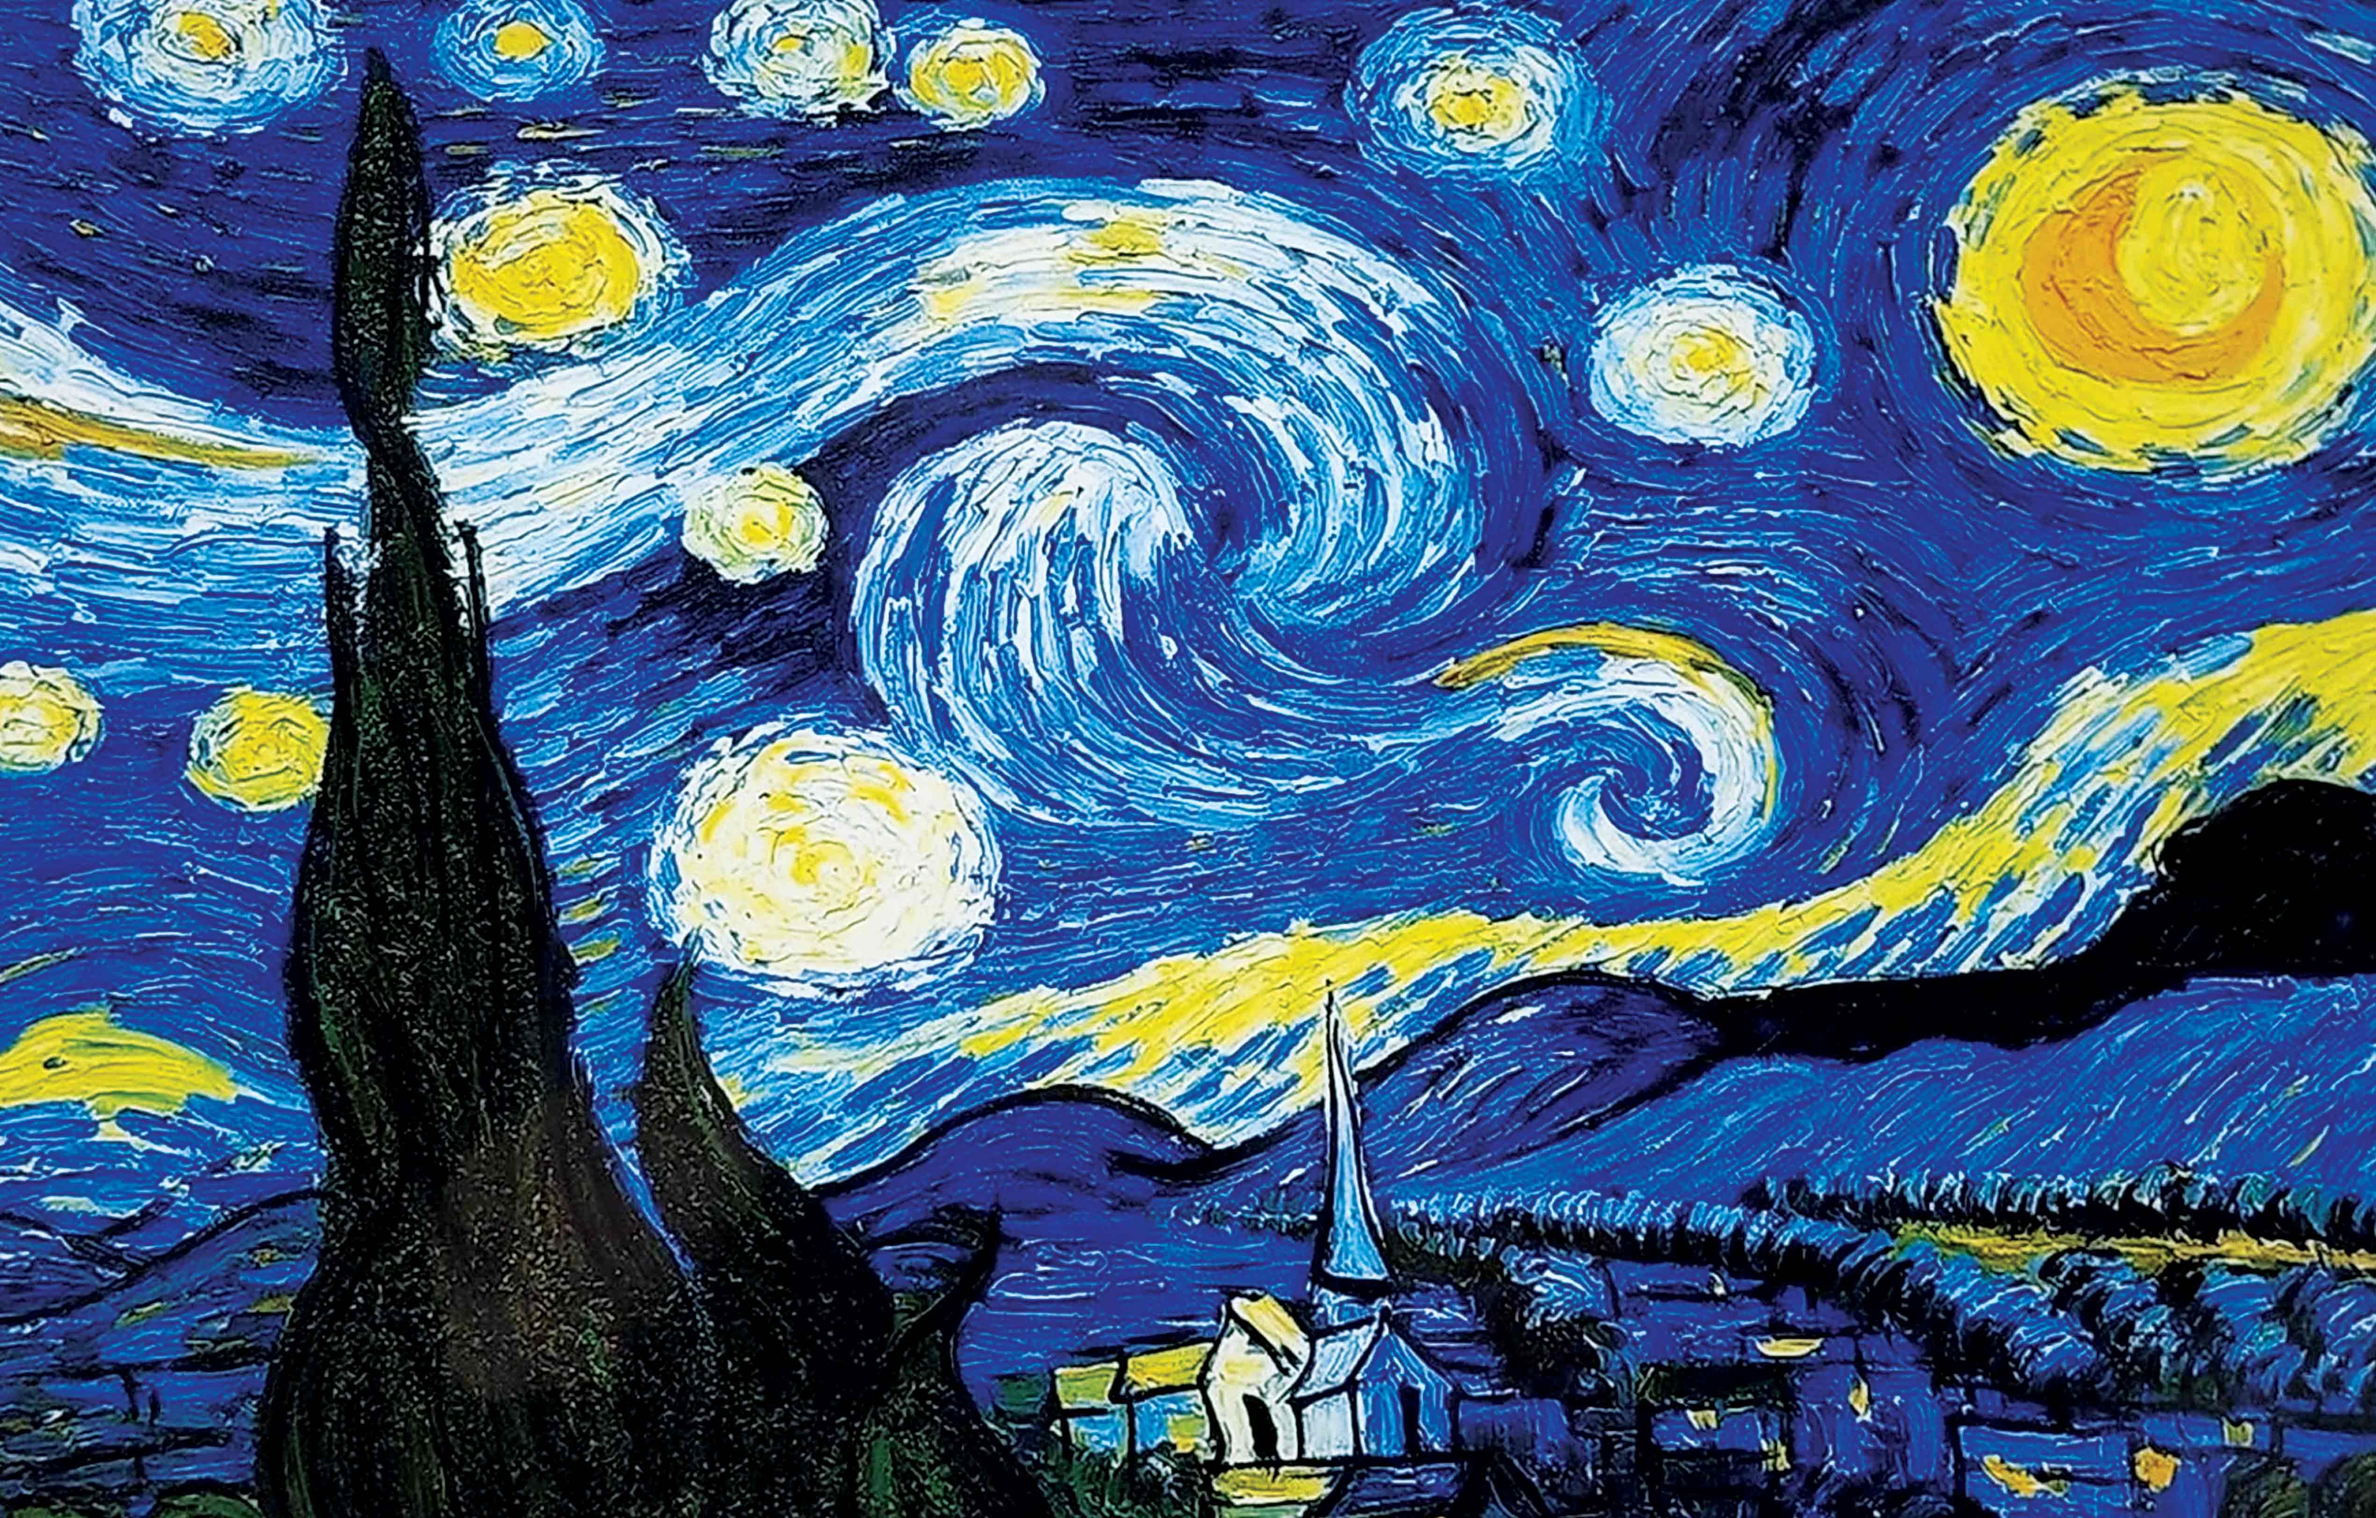
Q.6. NAME THE ART AND ITS ARTIST.

Slide 13
THE STARRY NIGHT
BY VINCENT VAN GOGH

Slide 14
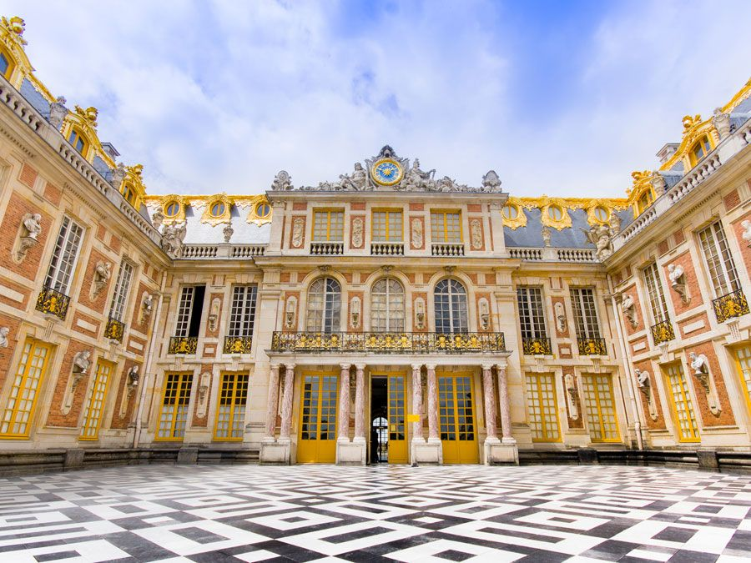
Q.7. NAME THIS PALACE WHICH WAS THE RESIDENCE OF KING LOUIS XVI AND ALSO ITS LOCATION.

Slide 15
THE PALACE OF VERSAILLES

Slide 16

Q.8.WHICH COUNTRY’S FLAG IS THIS ?

Slide 17
BHUTAN

Slide 18
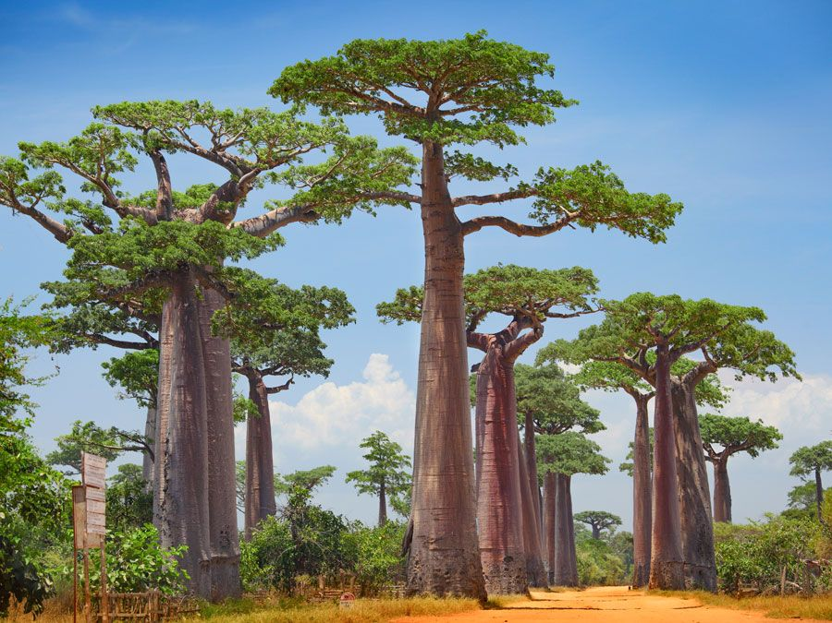
Q.9. NAME THIS FAMOUS TREE WHICH IS RELATED TO MYTHOLOGIES ?

Slide 19
BAOBAB

Slide 20
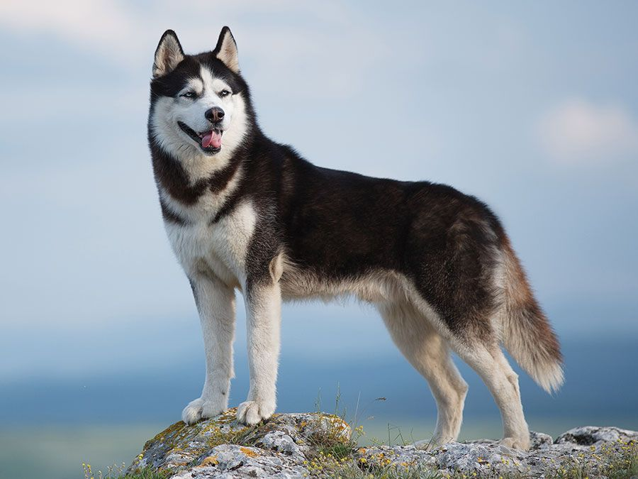
Q.10. NAME THIS DOG BREED

Slide 21
SIBERIAN HUSKY

Slide 22

Q.1. WHICH FAMOUS PERSONALITY’S VOICE IS THIS ?
AAMIR KHAN
VIRAT KOHLI
SACHIN TENDULKAR
ASHISH NEHRA

Slide 23
VIRAT KOHLI

Slide 24
Q.2. identify which bird’s sound is this ?
INDIAN HORNBILL
TOUCAN
KINGFISHER
FLAMINGO

Slide 25
Indian hornbill

Slide 26
Q.3. IDENTIFY THIS MUSICAL INSTRUMENT.
VIOLIN
SANTOOR
XYLOPHONE
VEENA

Slide 27
SANTOOR

Slide 28
Q.4. IDENTIFY WHICH BRAND’S ANTHEM IS THIS ?
SAVLON
DETTOL
CLINIC PLUS
LIZOL

Slide 29
DETTOL

Slide 30
Q.5.WHICH CARTOON CHARACTER’S VOICE IS THIS ?
DORAEMON
BEAST BOY
CHHOTA BHEEM
LITTLE SINGHAM

Slide 31
CHHOTA BHEEM

Slide 32
Q.6.WHICH GREAT PERSONALITY’S VOICE IS THIS ?

Slide 33
DR.APJ APDUL KALAM

Slide 34
Q.7. which ANIMAL’S SOUND IS THIS ?

Slide 35
RACOON

Slide 36
Q.8. IDENTIFY THIS CARTOON CHARACTER AS WELL AS NAME THE ARTIST WHO DUBBED THIS IN HINDI.

Slide 37
SIMBA
ARYAN KHAN

Slide 38
Q.9. IDENTIFY THIS PERSONALITY AS WELL AS TELL FROM WHICH FILM/WEB SERIES THIS DIALOGUE IS ?

Slide 39
PANKAJ TRIPATHI
MIRZAPUR

Slide 40
Q.10.WHICH TELEVISION SHOW’S TITLE TRACK IS THIS ?

Slide 41
TAARAK MEHTA KA
OOLTA CHASHMA

